Slide 1

Windows Application Allow Listing - Notes From the Field Start 15:25
Kim Oppalfens & Tom Degreef

Slide 2

Kim
Oppalfens
Senior Consultant

Slide 3

Tom
Degreef
Senior Consultant

Slide 4

What are we going to discuss?
8 points
1. WDAC Benefits
2. Applocker Comparison
3. OSCC Base policy
4. Gotchas
5. Handling Scripts
6. Catalogs
7. AppControl.AI
8. Training

Slide 5
1. Application Allowlist benefits
Why should we?

Slide 6

Ransomware cost
Based on CoveWare Ransomware report
Protects against 94% of automated malware & ransomware attacks (*)
Enforces solid processes and security practices
(*) 72.23% of all statistics are invented on the fly
$ 6.9 BILLION DOLLARS
1.1 BILLION DOLLARS
Notes:
https://www.r-bloggers.com/r%e2%81%b6-tracking-wannacry-bitcoin-wallet-payments-with-r/
https://www.herjavecgroup.com/hackerpocalypse-cybercrime-report/
https://www.forbes.com/sites/chuckbrooks/2022/06/03/alarming-cyber-statistics-for-mid-year-2022-that-you-need-to-know/
https://www.cnbc.com/2022/11/01/us-banks-process-roughly-1point2-billion-in-ransomware-payments-in-2021.html?utm_term=Autofeed&utm_medium=Social&utm_content=Main&utm_source=Twitter#Echobox=1667329365
The year of WDAC - April 2023 – OSCC
https://www.wired.com/story/ransomware-payments-2023-breaks-record/

Slide 7
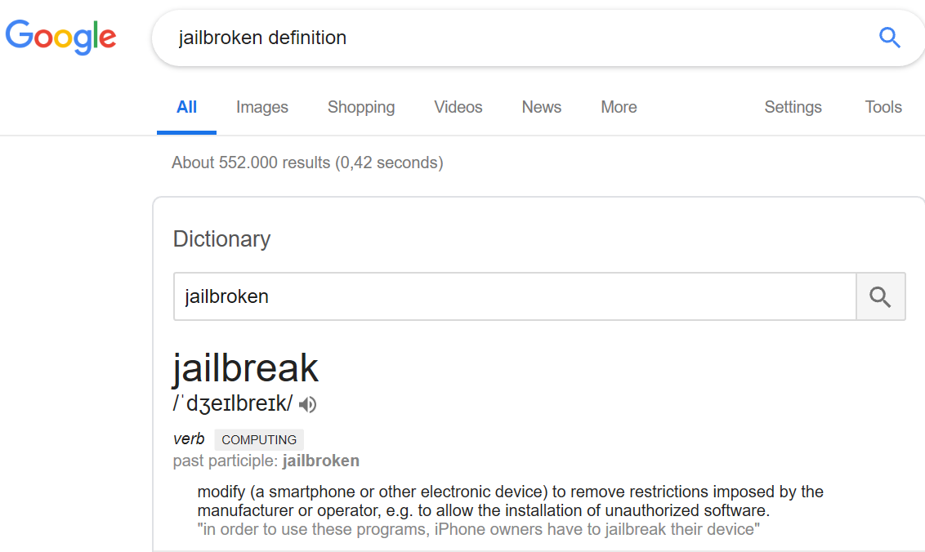
Application Allow listing
Aaron Margosis: “Can severely limit what an exploited vulnerability in a user program can accomplish.”
Kim Oppalfens: “Non-limited code execution will almost certainly result in full system compromise over time.”
A paradigm shift
Code integrity aka
Non-jailbroken Windows
“Modify an electronic device to remove restrictions imposed by the manufacturer or operator to allow the installation of unauthorized software.”
Notes:
Aaron Margosis – Microsoft Cyber Security (GPO Baselines)

Slide 8
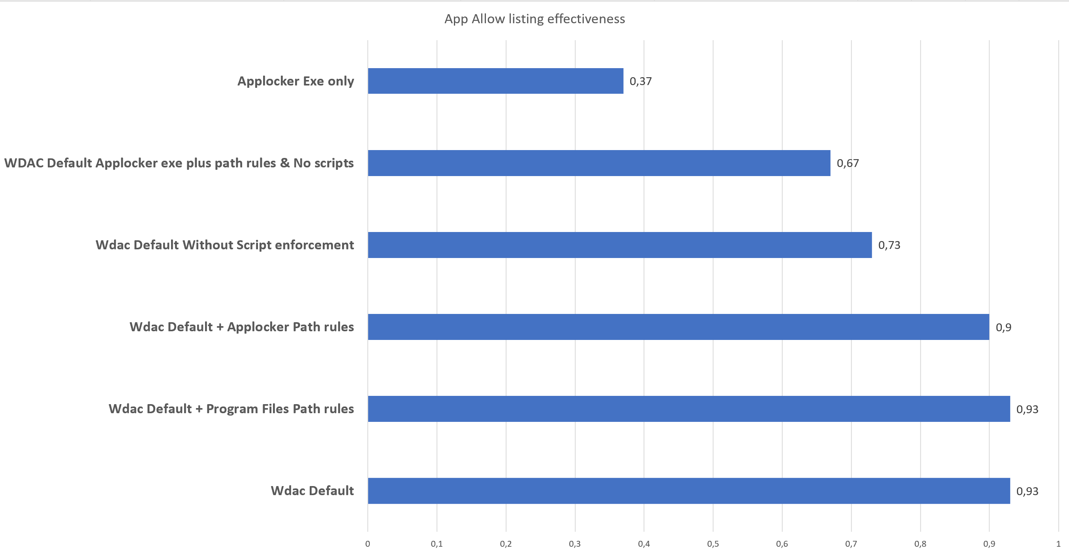
Recap – All of the stats
T

Slide 9
2. Applocker comparison
What's different?

Slide 10
WDAC Benefits over Applocker
Managed Installer
Maintained Recommended block rules
Runtime Permission Validation of Path Rules
Com Object rules
Documented Security Catalog approach
Per App rules
Integrated into Microsoft's Systems Management solutions
T

Slide 11
WDAC vs Applocker in Real live Printer Nightmare
OS Trusted based on signatures vs OS Trusted based on path rules
TL;DR
0-Day
Remote Code Execution + Privilege escalation to LocalSystem
Took Microsoft 3 months to patch all vectors
Bug in remote driver installation allows regular user to install printer drivers and drop DLL’s
Demystifying the PrintNightmare vulnerability (sygnia.co)
CVE-2021-34527 - Security Update Guide - Microsoft - Windows Print Spooler Remote Code Execution Vulnerability
Stopped by WDAC, DLL would not be allowed to execute
DLL is dropped in Windows\System32\spool\drivers which is allowed in default applocker rules

Slide 12
3. OSCC Base policy
Getting started

Slide 13
Rule options – OSCC's advice
0 - Enabled:UMCI
3 - Enabled:Audit Mode
4 – Prevent “Flighted” builds (EG: Windows insider)
6 - Enabled:Unsigned System Integrity Policy
9 - Enabled:Advanced Boot Options Menu
12 – Required: Enforce Store Applications
13 – Managed installer
16 - Enabled:Update Policy No Reboot
2 - Required:WHQL
19 - Enabled:Dynamic Code Security
T
Notes:
Bold = Delta with default
Bold + Italic = debatable, stronger security might be harder to implement

Slide 14
Recommended Rules
Code signer certificate
C:\Windows\Assembly FilePath rule
Microsoft recommended block rules
Deny Heartbeat executable
(Inbox) Windows Store app rules
T

Slide 15
Picking-order for generating trust
Managed Installer
Security Catalogs
(Supplemental) Policy
No additional work needed
Self-Documenting
Document properly
T

Slide 16
4. Gotchas
Things we learned over the years.

Slide 17
Gotchas (1)
The Windows Store
Python?
Signature based vs Package family name
Blocking store access?
File hash vs Authenticode hash
The Self-Updating app paradox
Failed app upgrades are seldomly problematic
FilePublisher rules (+Product Names)
Path rules if needs be

Slide 18
Create your initial packaged app policy
Get-AppxPackage | Out-GridView -PassThru | %{$Rules += New-CIPolicyRule -Package $_}
New-CIPolicy -Rules $rules -FilePath .\packagedapppolicy.xml -MultiplePolicyFormat -UserPEs
Set-CIPolicyIdInfo -BasePolicyToSupplementPath "basepolicy.xml" -FilePath .\packagedapppolicy.xml

Slide 19
Create packaged app policy
DEMO
Using PowerShell

Slide 20
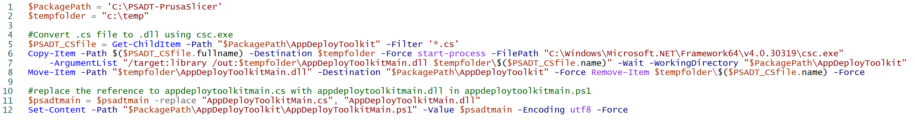
Gotchas (2)
PSADT C# File in AppDeployToolkitMain.PS1
T
Notes:
$PackagePath = 'C:\PSADT-PrusaSlicer'
$tempfolder = "c:\temp"
#Convert .cs file to .dll using csc.exe
$PSADT_CSfile = Get-ChildItem -Path "$PackagePath\AppDeployToolkit" -Filter '*.cs'
Copy-Item -Path $($PSADT_CSfile.fullname) -Destination $tempfolder -Force start-process -FilePath "C:\Windows\Microsoft.NET\Framework64\v4.0.30319\csc.exe" -ArgumentList "/target:library /out:$tempfolder\AppDeployToolkitMain.dll $tempfolder\$($PSADT_CSfile.name)" -Wait -WorkingDirectory "$PackagePath\AppDeployToolkit"
Move-Item -Path "$tempfolder\AppDeployToolkitMain.dll" -Destination "$PackagePath\AppDeployToolkit" -Force Remove-Item $tempfolder\$($PSADT_CSfile.name) -Force
#replace the reference to appdeploytoolkitmain.cs with appdeploytoolkitmain.dll in appdeploytoolkitmain.ps1 $psadtmain = Get-Content -Path "$PackagePath\AppDeployToolkit\AppDeployToolkitMain.ps1"
$psadtmain = $psadtmain -replace "AppDeployToolkitMain.cs", "AppDeployToolkitMain.dll"
Set-Content -Path "$PackagePath\AppDeployToolkit\AppDeployToolkitMain.ps1" -Value $psadtmain -Encoding utf8 -Force

Slide 21
5. Handling Scripts
PowerShell as an attack vector

Slide 22

The unsurmountable challenge of code signing
Create your own cert without a PKI
New-SelfSignedCertificate -Type CodeSigningCert -Subject 'Application control signing cert' -CertStoreLocation Cert:\CurrentUser\my
#!!! Add cert to Trusted Store !!!
Sign a file using that cert
Set-AuthenticodeSignature -Certificate $(gci Cert:\CurrentUser\My -CodeSigningCert |? {$_.Subject -like 'CN=Application control signing cert'}) -TimestampServer http://timestamp.digicert.com -HashAlgorithm sha256 -FilePath "file"
T

Slide 23
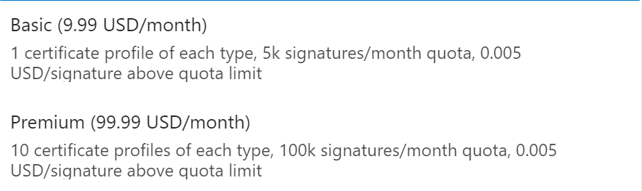
Azure Trusted Signing accounts
Fresh out of private preview
Service to allow codesigning files with Microsoft managed certificates
Developed with WDAC in mind
Automation friendly
Plenty of integrations (PowerShell, SignTool, Github actions)
Pricing
Trusted Signing documentation | Microsoft Learn
Notes:
Downloading a Device Guard Signing Service version 2 Root Certificate for MSIX - Systems Management Squad (sysmansquad.com)
Device Guard signing (Windows 10) | Microsoft Docs

Slide 24
Auto sign PowerShell
DEMO
Using VsCode
Notes:
cmd.exe /c "code.cmd --install-extension wk-j.save-and-run 2> NUL"
$settingsPath = "$env:APPDATA\Code\User\settings.json";
$data = Get-Content -Raw -Path $settingsPath -ErrorAction silentlycontinue | ConvertFrom-Json
$list = New-Object System.Collections.ArrayList
$list.Add(@{"match"=".ps[dm]{0,1}1$|.vbs$";"cmd"="set-authenticodesignature -Certificate `$(gci Cert:\CurrentUser\My -CodeSigningCert | Sort-Object -Property NotAfter -Descending | Select-Object -First 1) -timestampserver http://timestamp.digicert.com -filepath '`${file}'";"useShortcut"="false";"silent"="false"})
$list.add(@{"match"=".ps[dm]{0,1}1$|.vbs$";"cmd"="set-authenticodesignature -Certificate `$(gci Cert:\CurrentUser\My -CodeSigningCert | Sort-Object -Property NotAfter -Descending | Select-Object -First 1) -timestampserver http://timestamp.digicert.com -filepath '`${file}'";"useShortcut"="true";"silent"="false"})
$commands = @{"commands"=$list;}
if ($data)
{$data | Add-Member -MemberType NoteProperty -Name "saveAndRun" -Value $commands -Force}
$data | ConvertTo-Json -depth 5 | Out-file $settingsPath -Encoding utf8

Slide 25
6. Catalogs
Handling backlog

Slide 26
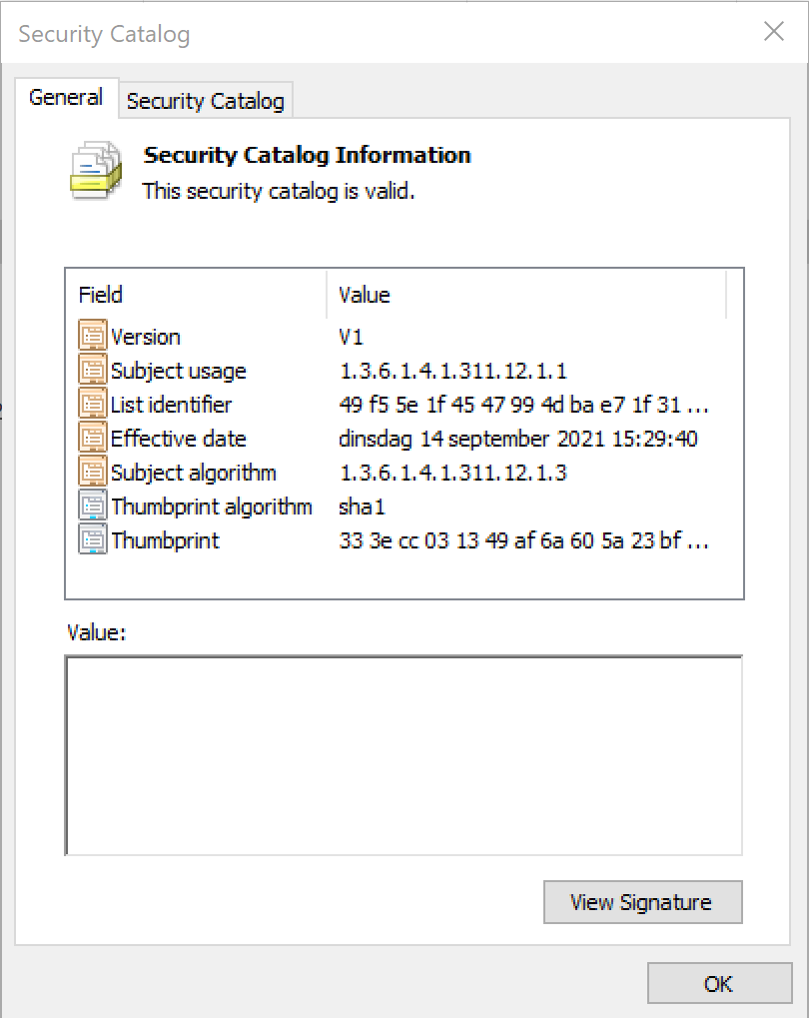
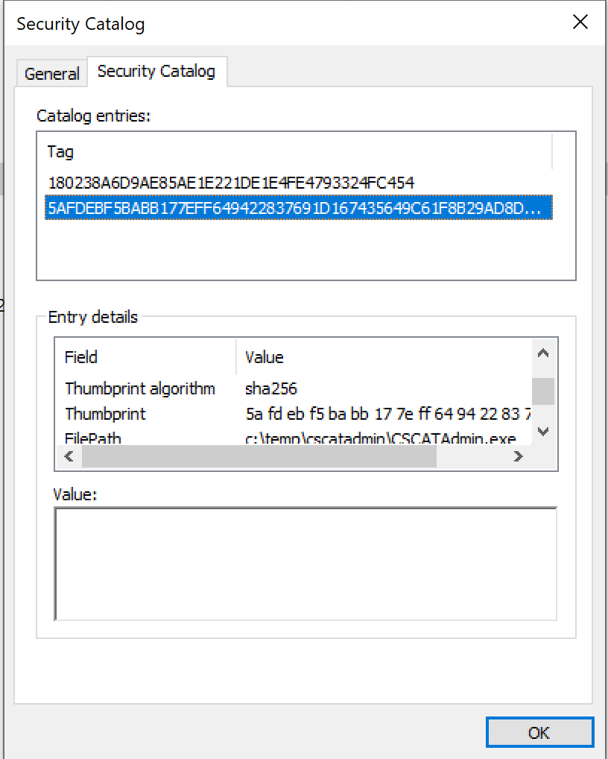
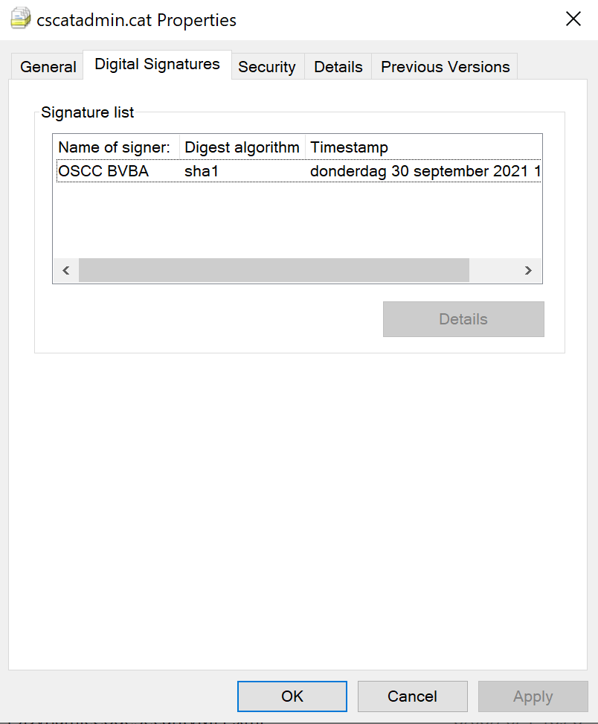
Handling Backlog
T
.cat files, Introduced 2 decades ago with Windows 2000 - Enforcement started in Windows XP
Driver signing is Kernel Mode Code Integrity
Windows Defender Application Control adds User mode Code Integrity
T
Notes:
Catalog Files and Digital Signatures - Windows drivers | Microsoft Docs
Protecting Anti-Malware Services - Win32 apps | Microsoft Docs

Slide 27
Make app trusted with signed Catalog monitoring
T
Enable Audit mode to capture temp files
Packageinspector.exe start C:
Copy source files of application
Install application to monitored disk drive
Packageinspector.exe stop –out cat -name application.cat
Sign catalog file with trusted Codesign Cert and Distribute
RTFM
T
Notes:
https://docs.microsoft.com/en-us/windows/security/threat-protection/windows-defender-application-control/use-code-signing-to-simplify-application-control-for-classic-windows-applications
Deploy catalog files to support Windows Defender Application Control (Windows) - Windows security | Microsoft Docs

Slide 28
PackageInspector
DEMO
Start / Stop

Slide 29
Make app trusted with Catalog Scan
T
Packageinspector.exe scan <pathtoscan>
Sign Catalog
Distribute Catalog to CatRoot folder
Check EventViewer for Additional Folders used by the application

Slide 30
7. AppControl.AI
Automated policy creation for managed apps
Automated security catalog generation
Enhanced Log Centralization
Deduplicated
Enriched
Advanced insights & dashboards in centralized portal

Slide 31
Assisted backlog handling
DEMO
AppControl.Ai

Slide 32
8. Training
Keep learning!

Slide 33
WDAC Masterclass at ViaMonstra
Starts 7th of November 2024 – Mail Tom.Degreef@oscc.be for 10% discount

Slide 34

Please evaluate this session in the App.
THANK YOU
Are there any questions?

Slide 35
<Next session 16:50 – 17:35>
Closing Note: AI: Afnemende Intelligentie?
Prof. Dr. Erik Scherder

Slide 36


Sprekers
Kim Oppalfens
Tom Degreef
Senior consultant
ExtraOrdinary Consultant

Slide 37
<Next session 16:50 – 17:35>
Closing Note: AI: Afnemende Intelligentie?
Prof. Dr. Erik Scherder

